Slide 1

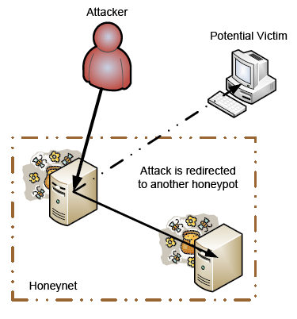
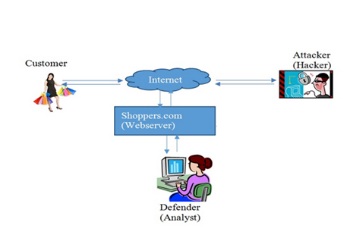


Applied Cognitive Science (ACS) Lab
Dr. Varun Dutt, Assistant Professor & Principle Investigator
IIT Mandi, H. P., India – 175001 Phone: +91-1905-267041 Email: varun@iitmandi.ac.in
Introduction to ACS Lab
Public perceptions of landslides in Himachal State (by Prateek Chaturvedi): Landslide is affecting almost all continents of the world causing massive damage to life and property, and often snap major communication links causing massive disruption in transport / supply network. Himachal Pradesh is extremely vulnerable to natural disasters due to its fragile geology, active tectonics, high relief, critical slopes and intense rainfall. Currently, there is a lot of technological and engineering research on developing mitigation options for landslide including developing sensor based early warning systems, geo-engineering, etc. However, as the decisions to adopt different technological and engineering options ultimately rests with people, research on the role of people, their understanding of landslide disaster, and their wait-and see behavior on disaster occurrence is also critically needed. The main purpose of the study is to 1) evaluate public perception of landslide risk and 2) investigate the role of certain cognitive manipulations on people‘s wait-and-see behaviour. The approach involves evaluating the basic knowledge, risk perception and attitude of people towards landslide risk by systematically manipulating certain conditions and collecting behavioral data while human participants make choices on landslide risk problems. The study has implications for improving risk awareness among people and provide better decision support to policy makers in countering risk due to landslides.
Fig 1. Landslide in Khaliyar (Mandi) (2007)
Public-goods game for Climate Change (by Medha Kumar): Climate Change is a global phenomenon that affects all nations across the globe. Disastrous consequences like melting of ice-caps, increase in sea level, global warming emerge as a result of climate change. One way to establish climate change is by using public-goods game in which players play a game by making investment towards private and public fund. The money put in public fund is multiplied by a factor and the return generated is equally divided amongst all players. Those who do not contribute anything also get their return. Ultimate goal of each player is to make a decision as to how much money to be put in public fund. Our study uses an experimental design to test human behaviour in terms of making investment towards averting climate change for various scenarios like presence or absence of information available, loss or no loss to other players.
Cyber Security:
Cyber Security: Understanding the Role of Deception as a Strategy in Cyber Attack Detection (by Palvi Aggarwal)
Cyber attacks, i.e., the disruption of normal functioning of computers and loss of private information through malicious network events, are becoming widespread. Current game-
theoretic approaches, which study the interaction between attackers and defenders, have focused less on the role of deception as a strategy to counter cyber attacks. Deception refers to falsely implicating attackers in honeypots in order to defend and capture network threats more accurately and timely (Figure 1). This research program aims to account for cognitive limitations on memory and recall for attackers and defenders and explore experiential decisions made by attackers and defenders in cyber-security games that involve deception. An important aspect of the project involves development of cyber-security games that enable us to manipulate deception as a strategy to counter cyber attacks. In such games, actions of attackers and defenders will be associated with payoffs and the goal of each player is to maximize her payoff. Next, the project will focus on the development of computational cognitive models of attackers and defenders. The model predictions will be tested by collecting human data in cyber-security games and comparing the model predictions to human decisions. Such an investigation will help improve current technical solutions and provide better decision support to defenders in countering cyber attacks via deception.
Building a secure and trustworthy cyberspace: A behavioral game-theoretic approach (by Zahid Maqbool): Cyber security is to be studied as a non-cooperative game between attackers and defenders using paradigms based on behavioral game theory and instance-based learning theory. The aim is to determine how a defender’s behavior (experience and tolerance to threats), as well as adversarial behavior (attack strategy), will impact the detection of threats. This program involves studying the influence of motivational factors (e.g., costs and benefits of actions from the attacker’s and defender’s viewpoint), environmental factors (e.g., information available to players about each other), and technology constraints (e.g., how network responds based upon the defender’s actions and network’s accuracy about reporting attacks) on the interaction between attackers and defenders while accountng for cognitive limitations such as the defenders’ and attackers’ memory and recall limitations, and their experiential decisions. This basic research program will help meet our nation’s cyber-security goals.
Decisions from Experience
Modeling Choices at the Individual Level in Decisions from Information Search (by Neha Sharma)
Decisions from Experience (DFE) involve situations where decision makers sample information before making a final choice. Trying various handsets before choosing a smartphone and enquiring about jobs before opting for one are some examples involving such situations. In DFE research, conventionally, the final choice that is made after sampling information is aggregated over all participants and problems in a given dataset. However, this aggregation does not explain the individual choices made by participants. In this paper, we test the ability of computational models of aggregate choice to explain choices at the individual level. Top three DFE models of aggregate choices are evaluated on how these models account for individual choices. A Primed-Sampler (PS) model, a Natural-Mean Heuristic (NMH) model, and an Instance-Based Learning (IBL) model are calibrated to explain individual choices in the Technion Prediction Tournament (the largest publically available DFE dataset). Our results reveal that all the three DFE models of aggregate choices perform well to explain individual choices. Although the PS and NMH models perform slightly better than the IBL model; the IBL model is able to account for all individuals in the dataset compared to the PS and NMH models. We conclude by drawing implications for computational cognitive models in explaining individual choices in DFE research.
Objective: The main focus of the lab is to investigate decision making and cognition in applied domains. Some of these domains include our environment, consumer behavior, cyber security, vehicle driving, natural disasters, and gambling etc.
Methodology: Our research methodology includes conducting laboratory experiments where we collect human behavioral data using simulation games (also called “microworlds”) and we use computational cognitive models based on the cognitive ACT-R architecture and other approaches to understand and predict such behavior. The lab is concerned in answering the following general questions: How does one’s experience influences one’s decisions? How certain kinds of experiences improve decisions and adaptation? How experience gathered in one situation performs in newer situations?
Resources: Our laboratory consists of post-doctoral fellows, graduate and undergraduate students, and student interns. The lab members come from different fields which include computer engineering, electrical engineering, and humanities and social sciences. The lab infrastructure includes an air-conditioned (hot and cold) environment with state-of-the-art 7 AIO desktops, 1 powerful workstation, Driving Simulator, Oxymeter, Emotiv Headsets, Tobii Eye Tracker, and other accessories.
Applications: Our results and conclusions extend to applied domains. For example, our conclusions may help understand the effects of existing designs on human cognition and how improvements to existing designs could enhance cognition. Our research could also help in developing training interventions in varied applied domains. For example, training security analysts against certain kinds of cyber-attacks could help improve their performance.
In summary, the ACS Lab is involved in studying human behavior by observing and collecting human performance in microworld tasks. Furthermore, it is also involved in developing cognitive models that reproduce observed behavior and predict new unobserved behavior within similar
Research in ACSLab
Environmental and Natural Decision Making:
Dr. Varun Dutt’s research:
Infrastructure in ACS Lab
1. All in one desktops, 2. Gaming gear, 3. Oxymeter, 4. Emotiv Headsets, 5. Tobii Eye Tracker, 6. Printer, 7. Headphone, 8. DVD Writer, 9. Air Conditioner

